Slide 1
Business case CEO
Btc PREDICTIVE
MODEL
EMMANOUIL IERONYMAKIS

Slide 2
EXECUTIVE SUMMARY
By building a new predictive model for BTC,
we expect to be able to identify BCT price
behavior more accurate.
This allows us to:
Have 25% more accurate investments for our risk tolerant clients.
Expect profits increases by 30% in a year.
Attract new clients who are interested in investing BTC.

Slide 3
PROBLEM STATEMENT
Currently the BTC risk advice, is solely based on the analysis of historical data.
From 2015-2022 price of BTC is heavily fluctuating.
Currently is challenging to identify the financial risks that our clients face when invest in BTC.
We don’t have a suggested action plan for our clients to decrease risk factors.
Our existing stock models, are not compatible as BTC has proven to behave differently.

Slide 4
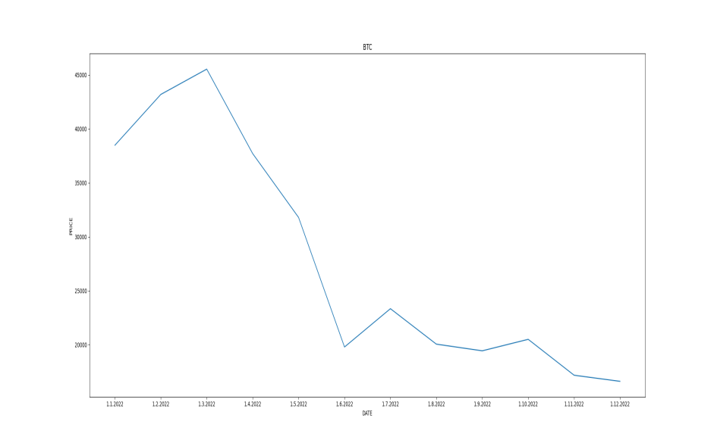
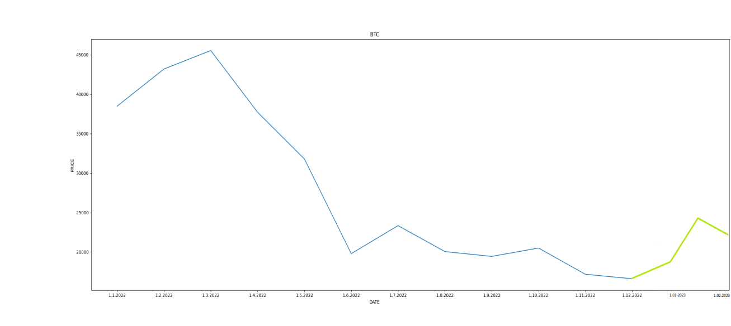
SOLUTION PROPOSAL
Create a new predictive machine learning model that analyze multiple BTC data to predict the future price more accurately.
?

Slide 5
BENEFITS
Increased certainty of our investments.
Improved company systems compatible to crypto market.
More BTC clients.
More BTC control.
More clients trust.

Slide 6
TIMELINE AND COSTS
6 months expected duration
4 full time employes (3 seniors and 1 junior)
Expected cost of this project: ~ $110.000
Expected company ROI:
($1.000.000*/$110.000) x 100 = 909%
After two investment periods (6 months)
*profit calculated based on acquiring 10 new clients and increasing profits for existing clients.
*ROI = Net income/ Cost of investment x 100

Slide 7
CONCLUSION
A new predictive BTC model.
25% more accuracy.
More reliable company models.
More clients.
Higher profits.
Technical project summary:
6 moths.
4 FTE
Cost of ~110.000$
909% ROI

